Slide 1
Read me: notes for instructors
Use: a PowerPoint and speaker notes meant to introduce undergraduate biology students to evolution using conflict-reducing practices.
A video of an instructor presenting this lesson was shown to reduce perceived conflict between religion & evolution, increase perceived compatibility between religion & evolution, and increase evolution acceptance in a randomized controlled study of over 2,000 undergraduate biology students: https://www.lifescied.org/doi/10.1187/cbe.24-05-0157
This lesson is not meant to be a comprehensive coverage of the science of evolution, but an introduction meant to increase students’ receptivity to further instruction.
If instructors would like to assign this as a video homework, they are free to use the following YouTube video of Dr. Liz Barnes presenting this slideshow: https://youtu.be/IRjlDRvOAGM?si=ar_tW6UKsz3QtnVx

Slide 2
Evolution:
An Introduction
Notes:
Hello biology students! Today, I’m really excited to introduce you to some important concepts in evolutionary biology.

Slide 3
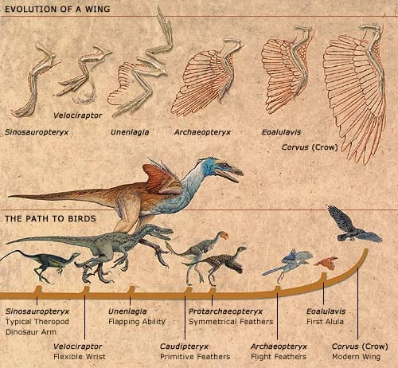
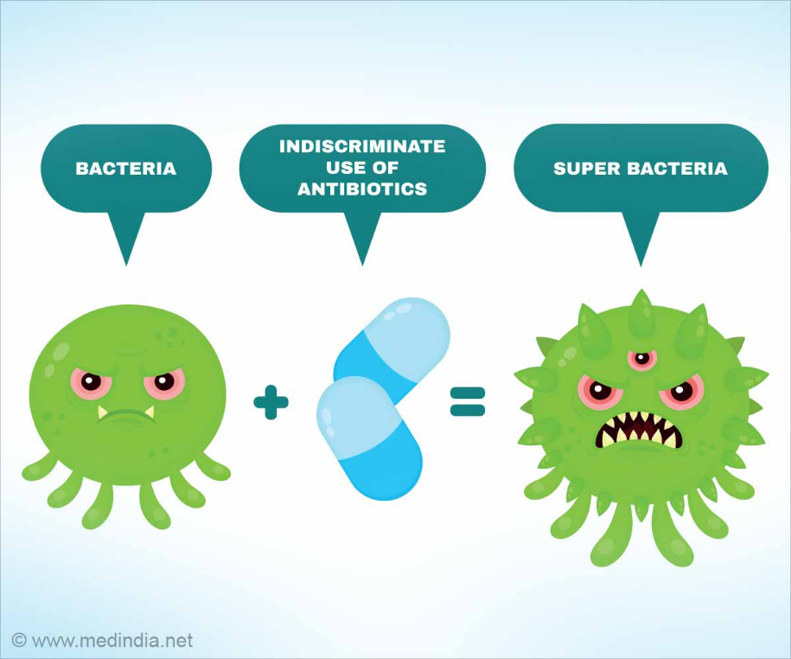
Evolution is change in a population of organisms over time
A population of mushrooms changing over time:
Questions that evolutionary biologists ask:
How did evolution happen in the past?
How does evolution happen today?
Antibiotic resistance
Generation 1
Generation 2
Generation 3
Notes:
But, what is evolution actually? In biology, evolution is change in a population of organisms over time
biologists study how evolution has happened in the past
And how it is still happening today

Slide 4
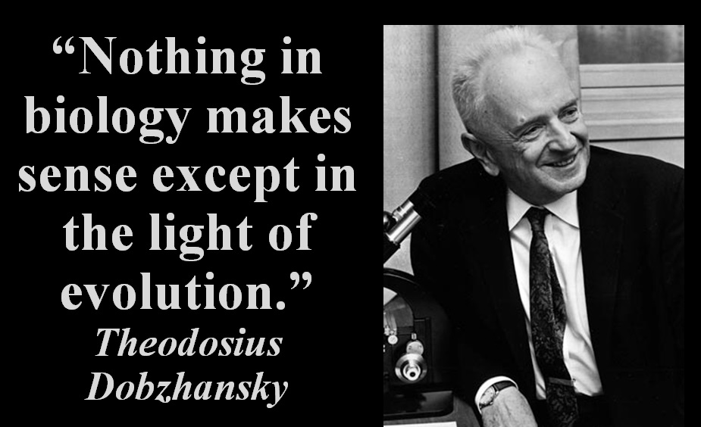
Evolution is the foundation of biology
Notes:
Evolution is considered by biologists to be the foundation of our entire discipline with many biologists saying that nothing in biology fully makes sense until we take into account evolution.

Slide 5
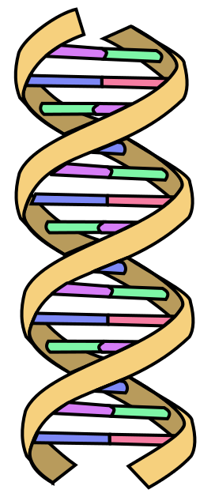

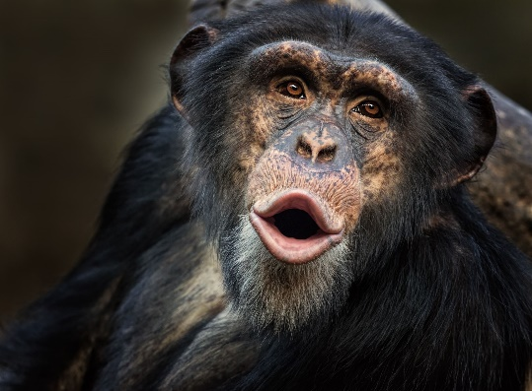
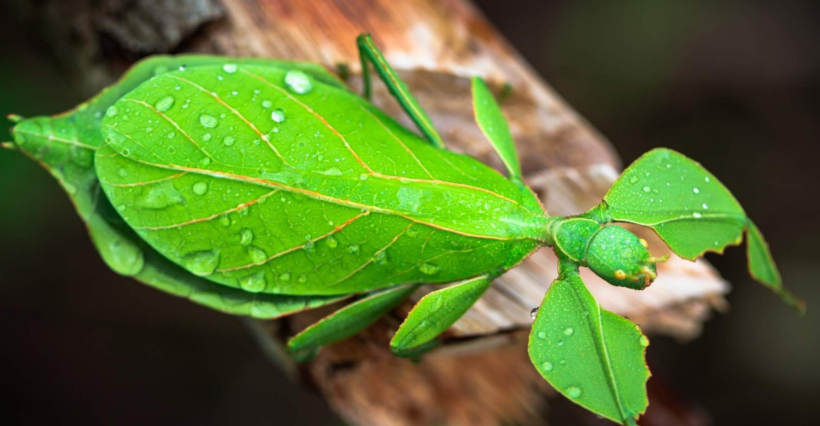
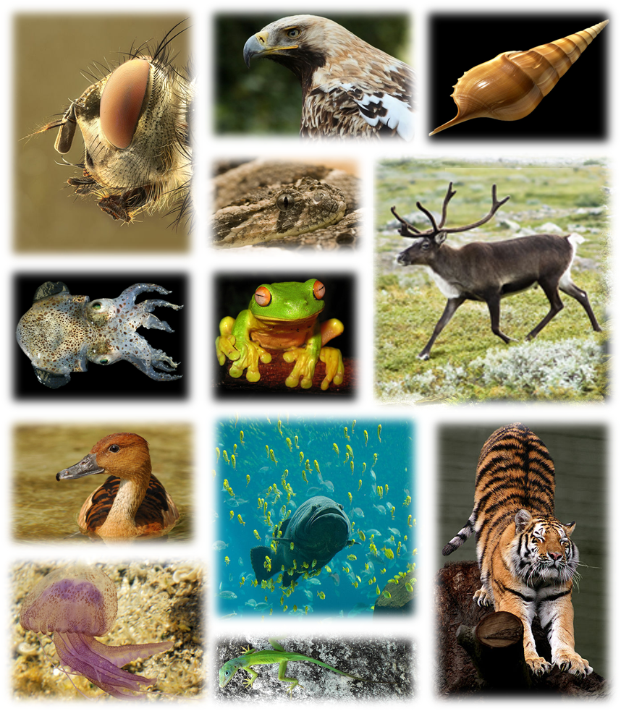
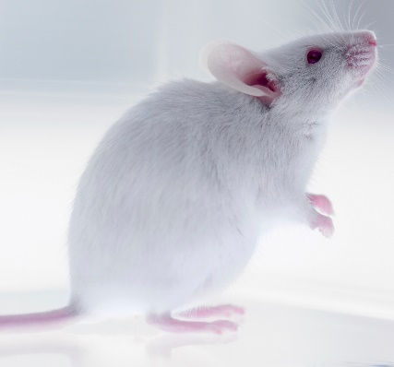

Evolution is the foundation of biology
Evolution explains:
How is life so similar?
How do adaptations and functional traits occur?
How did life become so diverse?
humans & humans
humans & chimps
~99.9% similar DNA
~96% similar DNA
humans & mice
humans & bananas
~70% similar DNA
~60% similar DNA
Notes:
because evolution explains so much about biology
Evolution explains how organisms came to function the way they do and how many organisms are such a good fit to their environment
And evolution solves the age-old conundrum in biology, why is life so diverse….
…but also incredibly similar in some of the most fundamental ways, like our DNA? For example, even though species are so different, humans share ~96% of their DNA with chimpanzees and ~60% of their DNA with a banana. Evolution explains this through the idea that all of life has evolved from a common ancestor.

Slide 6
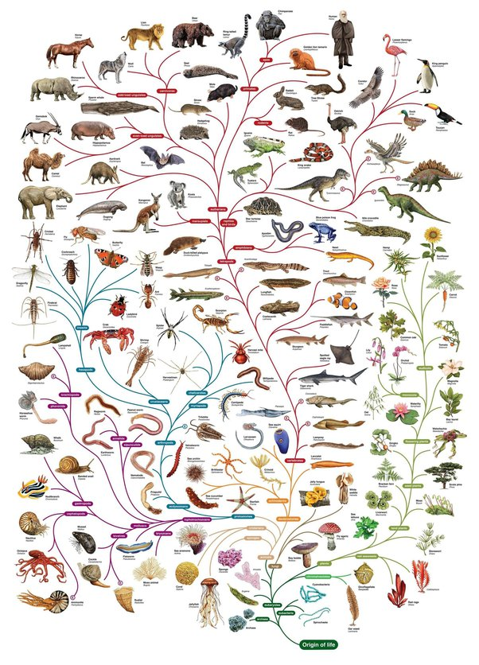

Humans
~300,000 years old
Life is one big family tree
Essentially all biologists accept evolution
Origin of Life
~3.8 billion years ago
Notes:
In fact, the grand implication of evolutionary biology is that all of life, including humans, are part of one big family tree that has been growing for more than 3.8 billion years from a common ancestor. The tips of the tree are like the existing species today and the branches and trunk represent our common ancestry. The evidence for this pattern of evolution is so strong that it is accepted by 98% of biologists. It is hard to be a biologist these days if you do not accept evolution.

Slide 7

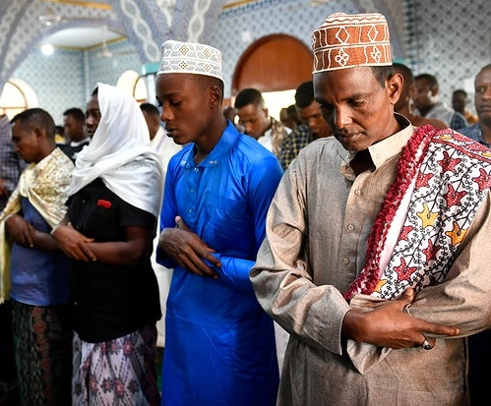



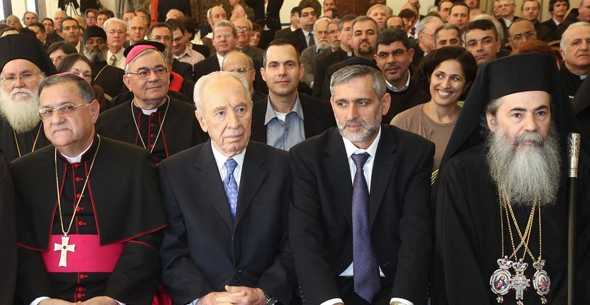
Some students worry that evolution conflicts
with their religious beliefs, cultures, and teachings
Church as Family
Religion is important to many students’ lives so a potential conflict with evolution can be worrying for students of faith
Notes:
However, some people find it hard to accept evolution as a good explanation for how humans and other organisms have developed
and one major reason for this is that people are concerned that evolution conflicts with their religious beliefs, culture, or teachings
Since these religious communities and belief systems are such a fundamental part of many students’ lives and identities
it is understandable how someone might struggle to accept evolution if it seems to contradict their religion.

Slide 8
***Note for instructors on next two slides:
The following two slides are examples of how an instructor can personalize their own story of perceived conflict between religion and evolution.
Instructors can choose to omit these slides if they are uncomfortable revealing their own background. Research suggests the lesson will still have positive impacts without these stories, but there may be extra benefits for some students who share the instructor’s background. Instructors should adapt these to be true to their experience.
The first slide is an example of a religious instructor who may be able to act as a boundary spanner for religious students. Although our randomized controlled study did not detect extra benefits of revealing a Christian identity for other Christian students, many other studies suggest students who see their own religious identity reflected in an instructor may feel more comfortable with learning and accepting evolution.
The second slide is an example of a non-religious instructor demonstrating cultural competence for religious students and serving as a role model for other non-religious students on how to reduce conflict between religion and evolution. Our randomized controlled study found that non-religious students were especially impacted by a non-religious instructor, showing a greater increase in perceived compatibility between religion and evolution compared to a religious instructor. Given that non-religious students tend to perceive less compatibility between religion and evolution than their religious peers, this is potentially important for increasing the overall religious cultural competence of the biology community.
For more information on how these different slides may impact students and the instructor, see the following published studies:
https://www.lifescied.org/doi/10.1187/cbe.24-05-0157
https://journals.asm.org/doi/full/10.1128/jmbe.00016-25

Slide 9
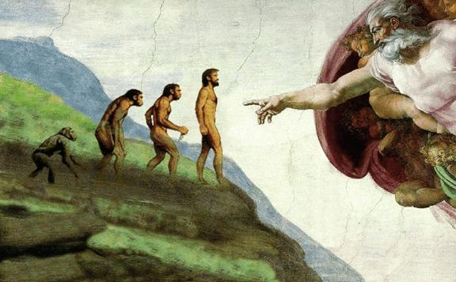
I also struggled with whether my religion was compatible with evolution.
God and evolution?????
???????????
INSERT PICTURE OF INSTRUCTOR
I was conflicted….
Now I teach evolution with examples of how evolution and religion do not have to be in conflict.
Notes:
I really understand this feeling because I was brought up in a very Christian family who thought evolution and religion were incompatible. So, when I went to college and learned about evolution, there was a period where I struggled with whether I could accept evolution as a Christian, especially because I saw other religious students in my classes who were sincerely struggling with whether to accept evolution as biology students. But ultimately, I came to realize that my faith and evolution were not really conflicting the way I had always perceived them to be and now I’ve become comfortable with both my beliefs as a Christian and my acceptance of evolution as a biologist. So now one thing I am really committed to doing is that when I teach evolution, I show ways that evolution and religion are not necessarily in conflict so, hopefully, they do not have to struggle with it as much as I did when I was a student.

Slide 10
I also struggled with whether religion is compatible with evolution.
God and evolution?????
???????????
INSERT PICTURE OF INSTRUCTOR
I was conflicted….
Now I teach evolution with examples of how evolution and religion do not have to be in conflict.
Notes:
I have my own experience having to reconcile religion and evolution, but as a non-religious person, actually. I grew up in a non-religious household and so there was no reason for me to doubt evolution when I learned about it in college. But I did think that evolution and religion were definitely in conflict because that was what I had seen and heard in our culture, that a belief in God and evolution were essentially incompatible. I also saw religious students in my classes who were sincerely struggling with whether to accept evolution as biology students. But I started to learn a lot about how religion and evolution did not necessarily conflict and now even as someone who does not have a religious faith, I understand how evolution and religion can be compatible. So, now one thing I am really committed to doing when I teach evolution is showing students ways that evolution and religion are not necessarily in conflict.

Slide 11

During this video lesson we are going to remain respectful of all students’ beliefs, even those who are hesitant towards evolution.
Ultimately, what you think about evolution is up to you alone.
But it is important you know the evidence for evolution and the views that exist about religion and evolution to inform your decision.
Notes:
But during this video, it doesn’t matter what your religious beliefs or your beliefs about evolution are. Whether you are a Christian, Atheist, Muslim, Agnostic or something else, I am going to do my best to present evolution in a way that is respectful of those beliefs because
Ultimately what you decide to believe about evolution is up to you based on your own evaluation of the evidence. To help inform your views however we are also going to talk a lot about the nature of science itself and about the different views that exist on religion and evolution. Then, we will cover the scientific evidence for evolution at the end of the video.

Slide 12
Science is limited to answering questions about the natural world
Science
Religion
What is the purpose of life?
How should one live?
What is moral?
What is the nature of God? Does God exist?
Natural explanations
Natural phenomenon
How? When? Where? What is the natural cause?
Evolution is agnostic about God/god(s)
Notes:
To fully appreciate different views on religion and evolution we must understand a bit about what science as a tool for gaining knowledge is able to do. Because often students believe that evidence for evolution somehow disproves the existence of God. However, it is more scientifically accurate to say that science and thus evolution, is agnostic about God -- evolution claims neither faith nor disbelief in God. Why?
Well because God is usually considered by most to operate outside of the natural world and science can only study things that operate inside the natural world.
So, science answers questions like, when did something happen, how did it happen, where did it happen and what will happen in the future if we take some course of action.
But whether God exists or how God influences the world is often seen as outside the realm of scientific inquiry because most people see God as operating as an entity operating outside of natural law. And it is OK that science can’t test that! We use many ways of gaining knowledge as humans not just science. For instance, science and philosophy are different disciplines for which unique knowledge is built. Knowledge from these different disciplines often do not conflict because they ask different questions and have different norms for what constitutes knowledge. In moral philosophy, for instance, people ask questions about what are the correct moral actions to take in life and what constitutes a good life? The role of religion is different for different people, but many people think that religion is a moral philosophy, answering questions about morality and the purpose of life. Religion also tends to address the existence and nature of a God or gods.

Slide 13
Science is limited to answering questions about the natural world
Science
Religion
What is the purpose of life?
How should one live?
What is moral?
What is the nature of God? Does God exist?
Natural explanations
Natural phenomenon
How? When? Where? What is the natural cause?
If science and religion do not answer the same questions, then there is no conflict but only dialogue and collaboration.
Evolution is agnostic about God/god(s)
Evolution is agnostic about God/god(s)
Notes:
Conflict between religion and science tends to occur when they try to answer the same questions – for instance when a scientist claims that science disproves God, they are trying to use science to answer questions about something that can not really be explored using science. When a person of faith says that the Bible disproves evolution, they are trying to use religion to explain the realm of science – but if science and religion answer different questions then they cannot conflict – they can only inform one another. For instance, science may not be able to tell us what ethics we should live by, but it can help live our values – whether they come from religion, philosophy, or just our moral intuition. For instance, many students want to become healthcare providers like doctors and nurses because they have a personal ethic of wanting to help people within their communities. Scientific researchers decide to conduct studies testing the effectiveness of life saving drugs because they have the personal ethic of wanting to reduce human suffering. Some scientists see their religion as shaping their values of serving others and reducing human suffering, which has informed the research and science they choose to conduct. So, although these areas can inform one another they do not need to conflict.
And since science is bound to answering questions about the natural world, evolution is most accurately agnostic about the existence or influence of God on the creation of life.

Slide 14
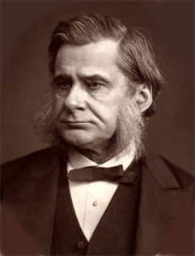
Thomas Henry Huxley, an early evolutionary biologist, coined the term agnostic to describe what was scientific in 1884:
“Agnosticism is of the essence of science … It means that [we] shall not say [we] know or believe that which [we] have no scientific grounds for professing to know or believe … Agnosticism simply says that we know nothing of what may be beyond natural phenomena.”
Notes:
In fact, an evolutionary biologist was the one who created the word “agnostic”. Thomas Henry Huxley was considered Charles Darwin's bulldog for his unwavering defense of evolutionary theory and he also coined the term agnostic specifically to describe scientific beliefs. He said that agnosticism is the essence of science and it means that we can’t say we know or believe things that we have no scientific grounds for claiming... This makes both the personal belief in both atheism and a God compatible with an agnostic science because an agnostic does not support or deny either view.

Slide 15
There is a spectrum of viewpoints
on the relationship between religion and evolution
Special creationism
Evolution with God
Evolution without God
Deistic evolution
Theistic evolution
Agnostic evolution
Atheistic evolution
Old Earth creationism
Human exceptionalism
Young Earth creationism
Interventionist evolution
Progressive creationism
Not in direct conflict with scientific evidence
Notes:
And this demarcation of science and religion opens a lot of possibilities of how one can view the relationship between religion and evolution.
Oftentimes, people think that you can have one of two views. Either you believe evolution and you’re an atheist
or you do not believe evolution and are religious.
However, there are a range of views in between these two stereotypes that represent different levels of compatibility between religion and evolution. You took a survey before this video in which you chose one of these views. Now we are going to go over them and describe the extent to which each one of these views are potentially compatible with evolution.

Slide 16
There is a spectrum of viewpoints
on the relationship between religion and evolution
Special creationism
Evolution with God
Evolution without God
Deistic evolution
Theistic evolution
Agnostic evolution
Atheistic evolution
Old Earth creationism
Human exceptionalism
Young Earth creationism
Interventionist evolution
Progressive creationism
Notes:
So first let’s talk about the views that most students are familiar with when they are thinking of evolution, which are the secular views of evolution.

Slide 17
Evolution without God/god(s)
Atheistic evolutionist
Agnostic evolutionist
Life shares a common ancestor and you do not believe any God/god(s) was involved in evolution
Life shares a common ancestor and
you are unsure if any God/god(s)
was involved in evolution
All Life
All Life
Not in direct conflict with scientific evidence
Notes:
Or views of evolution without God.
First, there is atheistic evolution which is the most extreme in terms of seeing religion and evolution as incompatible. Those who adopt atheistic evolution believe that all of life shares a common ancestor, as depicted by this tree of life here, and they also believe that a God or gods was not involved in this process. Most of the time these individuals do not believe in God at all.
But there is also agnostic evolution, which is also a secular view of evolution. Agnostic evolution represents those who believe that all of life shares ancestry, but they remain uncertain of whether any God or gods were involved in evolution.
Neither of these views are in direct conflict with scientific evidence, so those who hold these views tend to be considered accepting of evolution.

Slide 18
There is a spectrum of viewpoints
on the relationship between religion and evolution
Special creationism
Evolution with God
Evolution without God
Deistic evolution
Theistic evolution
Agnostic evolution
Atheistic evolution
Old Earth creationism
Human exceptionalism
Young Earth creationism
Interventionist evolution
Progressive creationism
Notes:
Next let’s talk about the other end of the spectrum in which there are views that can conflict with scientific evidence. We refer to these views as “special creationism” because according to these views, groups of organisms are created separately from one another, rather than sharing common ancestry.

Slide 19

Special Creationism
Human special creationism
Special creationism of “kinds”
Young and Old Earth
special creationism
Almost all forms of life evolved from earlier forms, but humans were created by God in their present form separate from the rest of life.
God created kinds of organisms such as reptiles, birds, and humans separate from one another, and organisms have evolved slowly from those first kinds.
All forms of life were first brought into being in their present form by God.
Tigers
Lions
Bobcats
Ocelots
Pigeons
Hawks
Eagles
Mice
Birds
Reptiles
Fish
Bacteria
Plants
Mammals
Non-humans
Humans
All in direct conflict with scientific evidence
Notes:
For instance, human special creationism is the idea that all of life on Earth shares common ancestry except for humans who were specially created by God separately from the rest of life on Earth.
So, this would be like the one big tree of life like we have seen before, but with humans growing separately, like a blade a grass away from the rest of the tree. And this is where you start to see a deviation from the cohesive tree of life that is supported so heavily by scientific evidence.
Further, some people believe in a sort of hybrid special creationism with some evolution, and we call this the “created kinds” view because these individuals believe that God created groups of organisms like birds, reptiles, and plants separately from one another and then these kinds evolved and diversified
So, this would be more like an “orchard” view of life in which there are many trees of life created separately from one another.
Finally, there is also young earth and old earth creationism. Both of these views include the least amount of evolution compared to the rest. They assume that God created almost all species separate from one another with only very little change occurring since the first creations.
So rather than a tree of life, or an orchard of life, each species is like a blade of grass created separately from one another. Old Earth views tend to be more in line with the scientific consensus than young earth views because young earth folks tend to believe that the Earth is 6,000 – 10,000 years old which goes against the evidence that the Earth is ~4 billion years old.
But all of these views are at least to some degree in direct conflict with scientific evidence.

Slide 20
There is a spectrum of viewpoints
on the relationship between religion and evolution
Special creationism
Evolution with God
Evolution without God
Deistic evolution
Theistic evolution
Agnostic evolution
Atheistic evolution
Old Earth creationism
Human exceptionalism
Young Earth creationism
Interventionist evolution
Progressive creationism
Notes:
So now let’s talk about these views in this middle category in which people both accept evolution and God.

Slide 21
Evolution with God/god(s)
Theistic evolution
(evolutionary creation)
Interventionist evolution
Deistic evolution
Life shares a common ancestor,
God intervenes to shape or override the evolutionary process
Life shares a common ancestor,
God planned evolution perfectly so that no intervention was necessary
Life shares a common ancestor,
God set evolution in motion without a specific purpose
or plan.
All Life
All Life
All Life
Not in direct conflict with scientific evidence
Notes:
There are three we will talk about today. And all three of these views incorporate the idea that all of life shares a common ancestor. But they also incorporate the idea that God uses evolution to shape life. There are slight differences between these three that can have important theological implications for people of faith.
For instance, interventionist evolution allows a role for God to actively intervene in the world to shape or override evolutionary processes for a specific purpose when needed.
There is also theistic evolution in which one believes that an all-knowing God planned evolution perfectly so that no intervention was necessary.
Finally, there is deistic evolution, which is the idea that God set evolution in motion but did not have a specific plan or purpose for the evolution of life on Earth.
Importantly, none of these views are in direct conflict with scientific evidence because they all suppose that life shares a common ancestor and has evolved.

Slide 22
There is a spectrum of viewpoints
on the relationship between religion and evolution
Special creationism
Evolution with God
Evolution without God
Deistic evolution
Theistic evolution
Agnostic evolution
Atheistic evolution
Old Earth creationism
Human exceptionalism
Young Earth creationism
Interventionist evolution
Progressive creationism
Not in direct conflict with scientific evidence
Notes:
So, coming back to our diagram again on the spectrum of viewpoints. There are many views on the relationship between religion and evolution. Including views that have a God’s involvement and those that don’t. There are some views in which people both believe in God and accept evolution and views in which people don’t believe in God and accept evolution, both of which are not in direct conflict with scientific evidence.

Slide 23
There is a spectrum of viewpoints
on the relationship between religion and evolution
Special creationism
Evolution with God
Evolution without God
Deistic evolution
Theistic evolution
Agnostic evolution
Atheistic evolution
Old Earth creationism
Human exceptionalism
Young Earth creationism
Interventionist evolution
Progressive creationism
Evolution and religion
are potentially compatible here
All these views are usually present within and across all religions
Notes:
Evolution and religion are potentially compatible for those who hold interventionist, theistic, deistic, and agnostic views of evolution. And interestingly one’s religion does not determine their view. These views are all present within and across religions.

Slide 24

The Clergy Letter Project
http://www.theclergyletterproject.org/
Over 17,337 signatures from leaders within different religions supporting compatibility between their religion and evolution.
Notes:
Within all religions there are both people who support and do not support evolution. Most religions do not have official stances for or against evolution.
One place you can go to read about ways religious leaders have reconciled their religion with evolution is to go to the Clergy Letter Project website.
This website contains testimonials from religious leaders across different religions who have written about their views on religion and evolution. Further, the website also has over 17 thousand signatures from religious leaders who signed a letter in support of the compatibility between religion and evolution.

Slide 25
Christianity
Catholic
Orthodox
Protestant
Latter-day saints
(formerly Mormons)
Roman Catholic
Reformed Catholic
Eastern Orthodox
Oriental Orthodox
Anglican
Baptist
Methodist
Pentecostal
Lutheran
Often divided by:
Evangelical
Mainline
The Church of Jesus Christ of Latter-day Saints (CJCLDS)
Community of Christ
The Church of Jesus Christ
Non-denominational
Doesn’t subscribe to separation of denominations
Evolution acceptance for Christians is not denomination specific but depends on how literally one reads the story of Genesis in the Bible.
Notes:
Here in the United States Christianity is the largest religious group with many denominations and none of these denominations have official stances for or against evolution. There is certainly perceived conflict with evolution in certain Christian communities, based on their specific interpretation of the Bible, but this is not attributable to the official teachings of the religion.
Within these denominations the Churches generally approve of accepting or rejecting evolution – they simply do not tend to see the science of evolution as ultimately having to conflict with the religion. Most rejection of evolution is specific to the culture of someone’s specific religious community, so the specific Church they attend, and the beliefs of their friends and family that share their religion. Most of the time this comes down to the extent that people within that religious culture believe in the literal creation story within Genesis in the Bible.

Slide 26
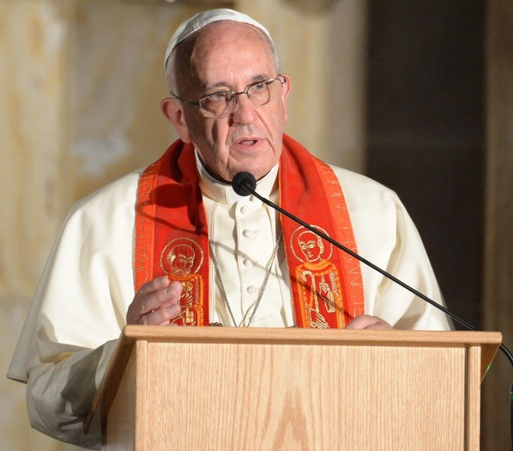
The Catholic Church
“When we read about Creation in Genesis, we run the risk of imagining God was a magician, with a magic wand able to do everything. But that is not so…God is not a magician, but the Creator who brought everything to life,”
“Evolution in nature is not inconsistent with the notion of creation, because evolution requires the creation of beings that evolve.”
Pope Francis
All Life
Notes:
And although Christian denominations do not have official stances on evolution, some of the leaders within these denominations have spoken about their own views on evolution and reading Genesis literally. For instance, the current Pope said (read quote) and this again underlies the idea that life sharing ancestry is not incompatible with God also creating life.

Slide 27
Theodosius Dobzhansky, Christian, Evolutionary Biologist
"I am a creationist and an evolutionist. Evolution is God's, or Nature's, method of creation. Creation is not an event that happened in 4004 BC; it is a process that began billions of years ago and is still under way”
“Does the evolutionary doctrine clash with religious faith? It does not.”
Notes:
And it is not just religious leaders that have said this but also evolutionary biologists as well. Remember Theodosius Dobzhansky who said that “Nothing in Biology Makes sense except in the light of evolution?” well he was a pioneer scientist in evolutionary biology and in that very same essay where he wrote that quote, he also talked about how he reconciled his religious faith with evolution. He said (read quote).

Slide 28
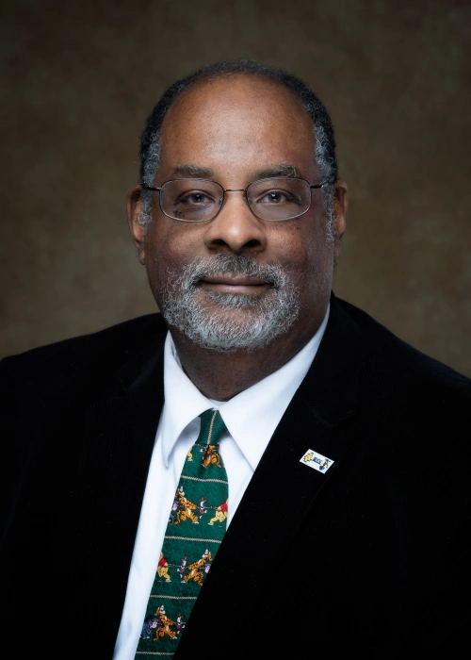
Joseph Graves, Christian, Evolutionary Biologist
Professor of Biological Sciences at North Carolina Agricultural and Technical State University
Has contributed greatly to the evolutionary science of ageing.
Discusses how his faith and evolution do not conflict when he teaches evolution.
Notes:
In addition to historical evolutionary biologists some modern evolutionary biologists also hold this view. Joe Graves is an evolutionary biologist North Carolina Agricultural and Technical State University and he has contributed greatly to our understanding of how evolution shapes ageing. So, have you ever wondered why we have to age? Why do mice age faster than humans? Well Dr. Graves’ work ahs contributed to our understanding of that. He is also known for his advocacy for evolution education and the idea that evolution and religion do not have to be in conflict.

Slide 29
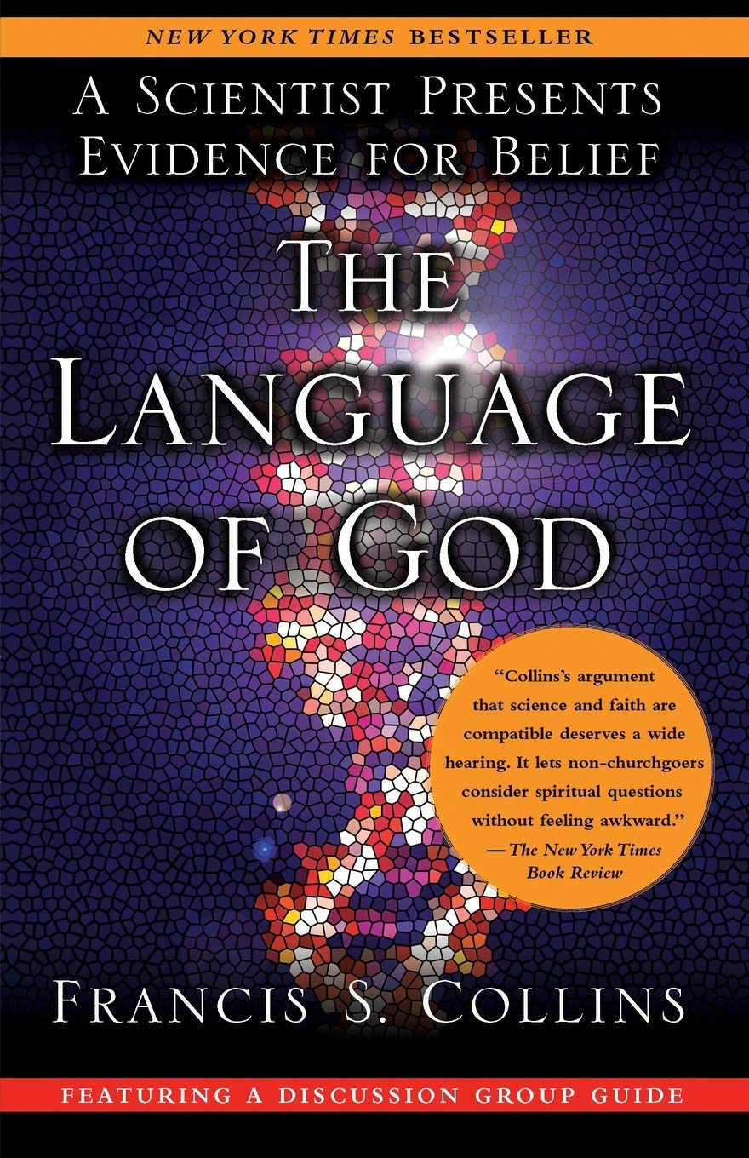
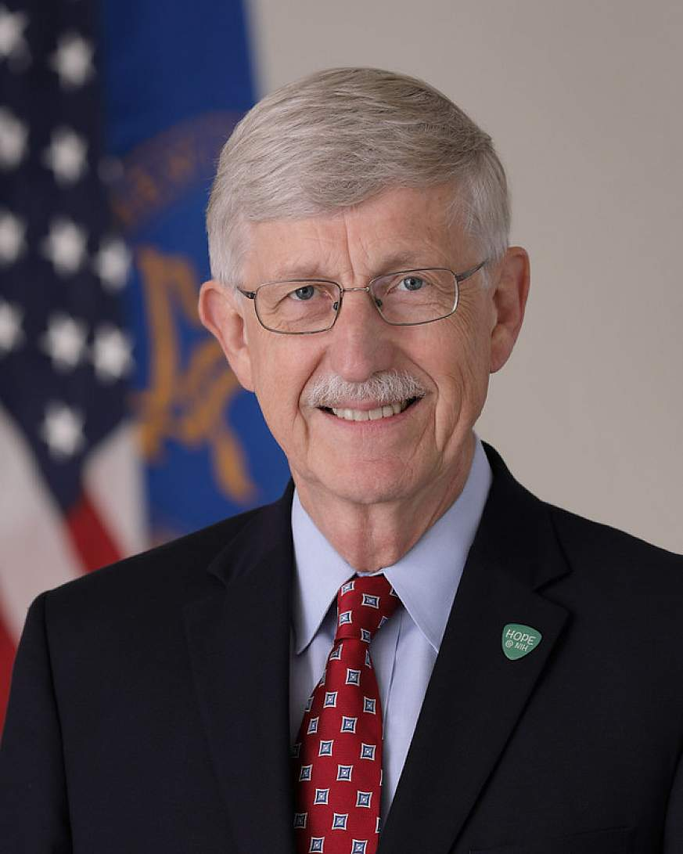
Francis Collins, Evangelical Christian, Physician - Geneticist
Served under three presidents as the Director of the National Institutes of Health (NIH) 2009 - 2021
Director of the first project to map the human genome
Founder of BioLogos an organization promoting that Christianity can be reconciled with acceptance of evolution and science.
Notes:
And there are also examples of prominent evangelical Christian scientists that promote harmony between religion and evolution. Dr Francis Collins is an influential biologist – he served under three US presidents as the director of the national institutes of health and was the leader of the first group to decode the human genome. He also is open that he is an Evangelical Christian and founded a whole organization and wrote a New York Times bestselling book advocating for the harmony between evolution and religion.

Slide 30


Fatimah Jackson, Muslim, Anthropologist
Professor of Biological Sciences at Howard University
Studies human and plant co-evolution.
Was awarded the 2020 Charles Darwin lifetime achievement award for her work in evolutionary biology.
Notes:
And it is not just Christian scientists there are also evolutionary biologists from Hindu, Jewish, Buddhist and even Muslim backgrounds. Fatimah Jackson is an example of a Muslim scientist who studies evolution. She studies how humans and plants co-evolve and was awarded the 2020 Charles Darwin Lifetime Achievement Award from the American Association of Physical Anthropologists.

Slide 31
So, what is the evidence for evolution?
Fossil Record
Similarities Between Organisms
Biogeography
Direct Observations
Notes:
So then what is the actual evidence for evolution that has been so convincing to all these biologists? Well, we will go over four major areas of evidence: The Fossil Record, Similarities between Organisms, Biogeography, and direct observation.

Slide 32
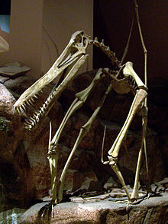
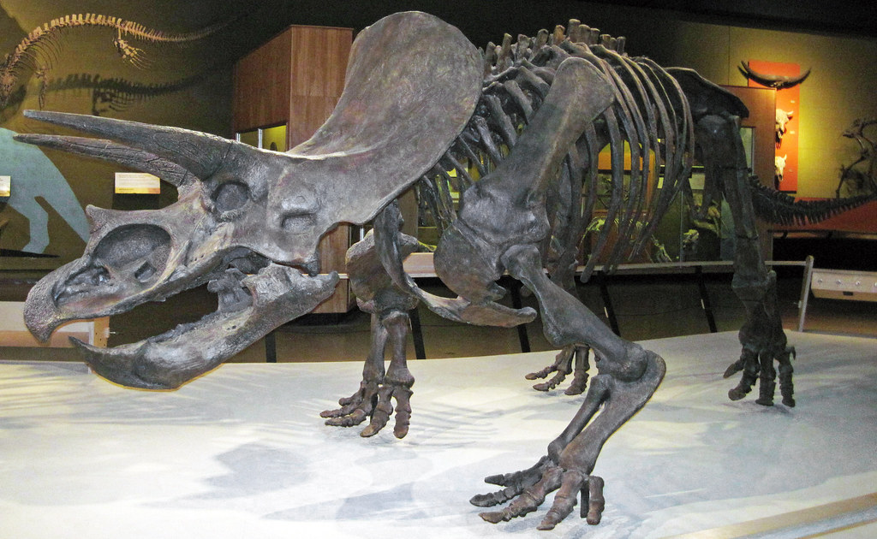
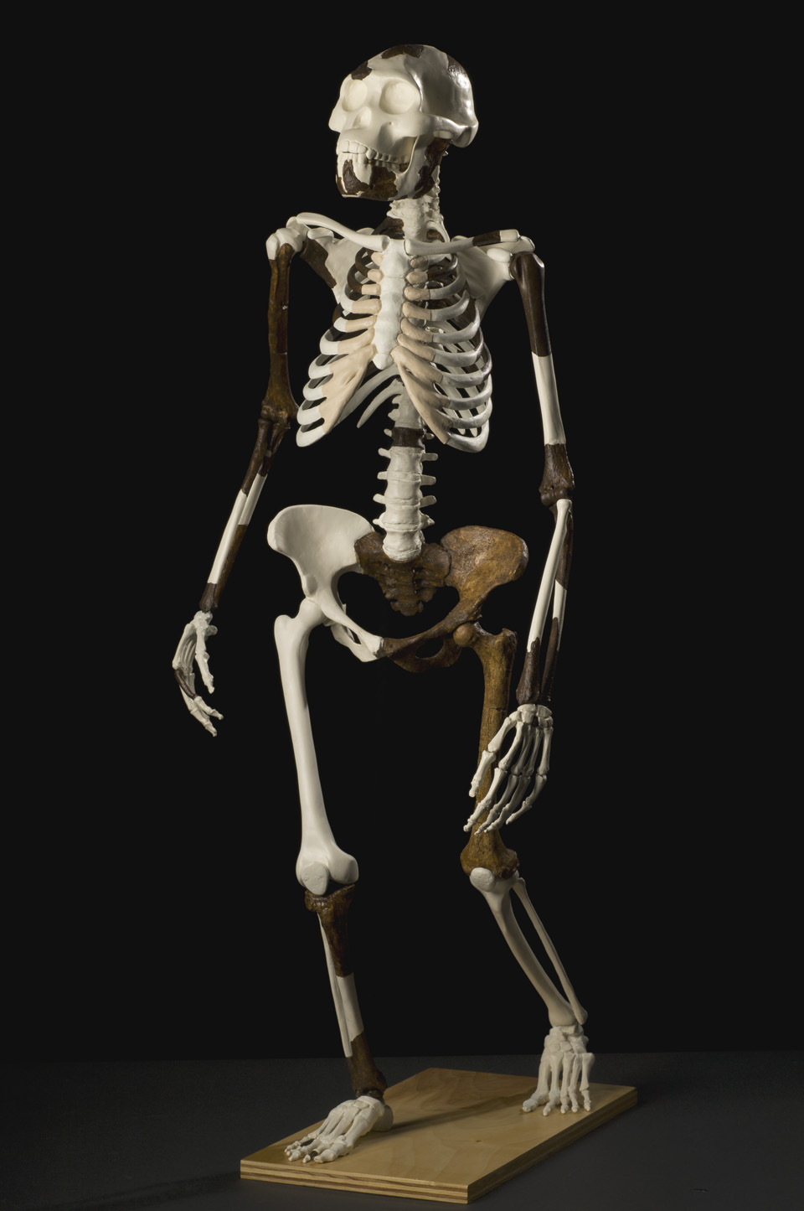
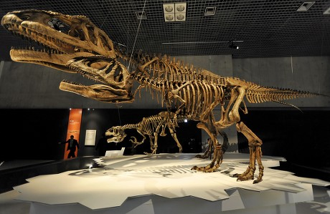
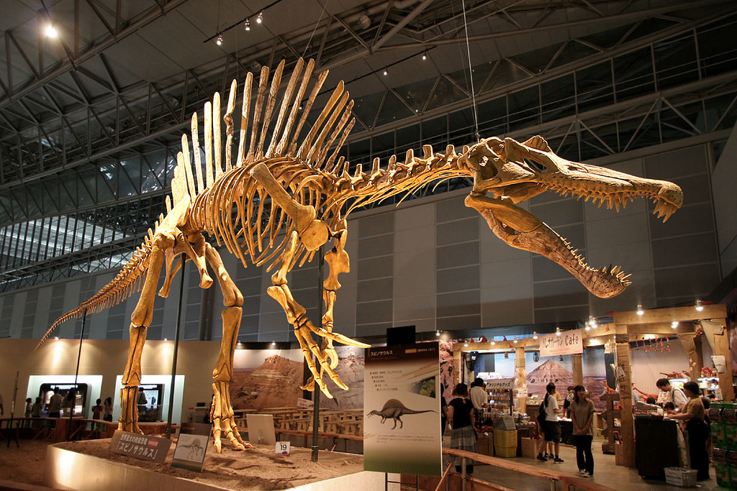
The fossil record shows life is not the same now as in the past
The fossil record shows life is not the same now as in the past
Pterosaur fossil
Tricepratops fossil
Therapod fossil
Spinosaurus fossil
Hominid fossil
Notes:
One of the most striking pieces of evidence for evolution is the fossil record. When we explore the dirt and rock on Earth that has formed from the ages and ages that came before us, we discover the fossilized remnants of fantastical creatures that we no longer see on the face of this planet – dinosaurs, flying reptiles, and ancient creatures that look mysteriously like human-chimpanzee hybrids. But most of these creatures are now extinct. We no longer find them here. So, we know for a fact that life now looks much different now than it did in the past.

Slide 33
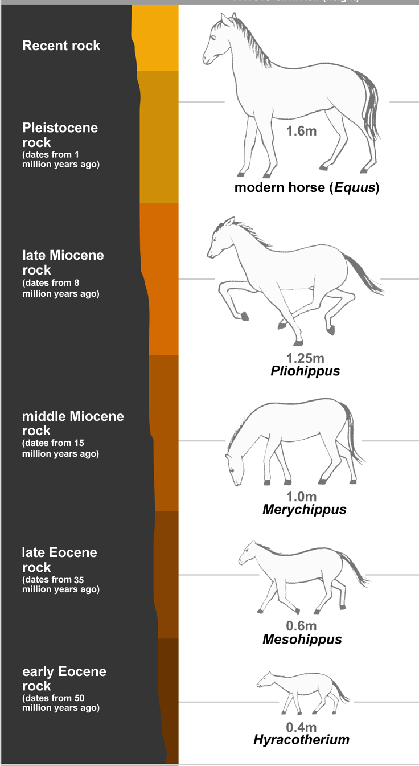
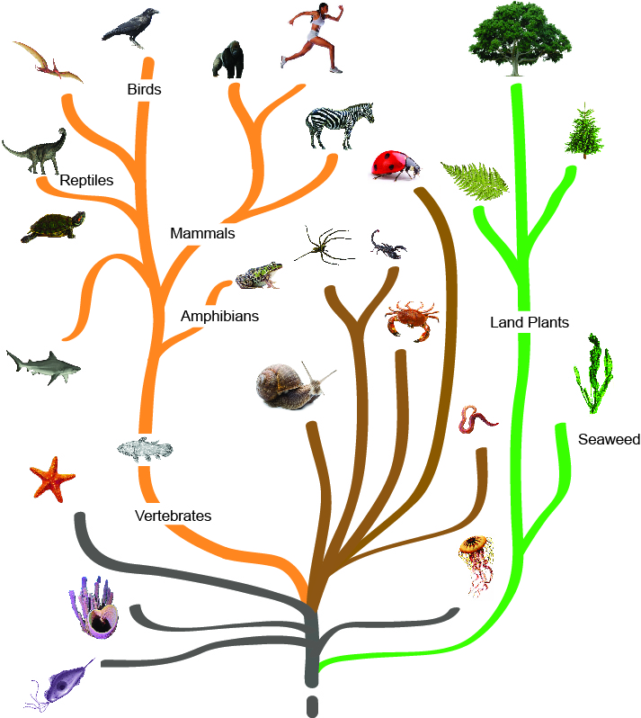

Fossils appear in patterns that show species changing through time
Each layer was deposited at a different time period
Older layers tend to be further down at the bottom
The patterns of fossils found in the layers match the pattern of the evolutionary tree of life
We can see the fossils gradually change between the layers
Notes:
And these fossils were deposited in clear patterns throughout time… because layers of Earth are deposited in somewhat of a predictable pattern. This is the grand canyon and you can see different geological layers in the canyon. Over millions of years water has eroded the rocks and revealed these layers. And this type of layering can be found all over the world. One reason we know an asteroid killed the dinosaurs is because asteroids are rich in a substance called iridium and there is an iridium filled geological layer across the entire globe that dates back to 60 million years ago – right when the dinosaurs went extinct. So, we can look at these layers and actually see what life looked like before and after that iridium layer by examining the fossils. When we do that we see that almost all dinosaur fossils, except for birds, are absent after that layer.
And when we look broadly at the order in which fossils are found, we can actually see species changing through time throughout the layers. We have an incredible fossil record that depicts the evolution of horses clearly throughout the geological layers.
And the order that fossils are deposited match exactly what we would expect if life all shared common ancestry. We have never found fossils of humans for instance among fossils from millions of years ago before other apes appeared in the fossil record – we only find humans after the other great apes appear and that is exactly what we would expect to see if we evolved from other great apes.

Slide 34

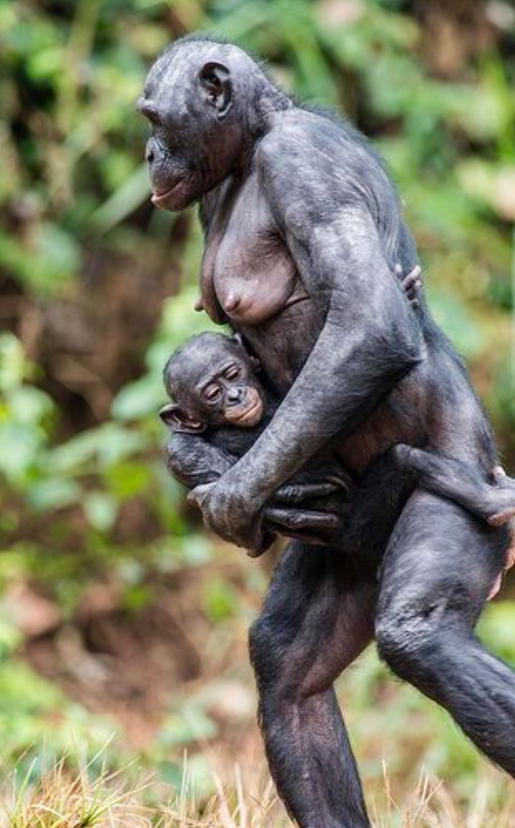
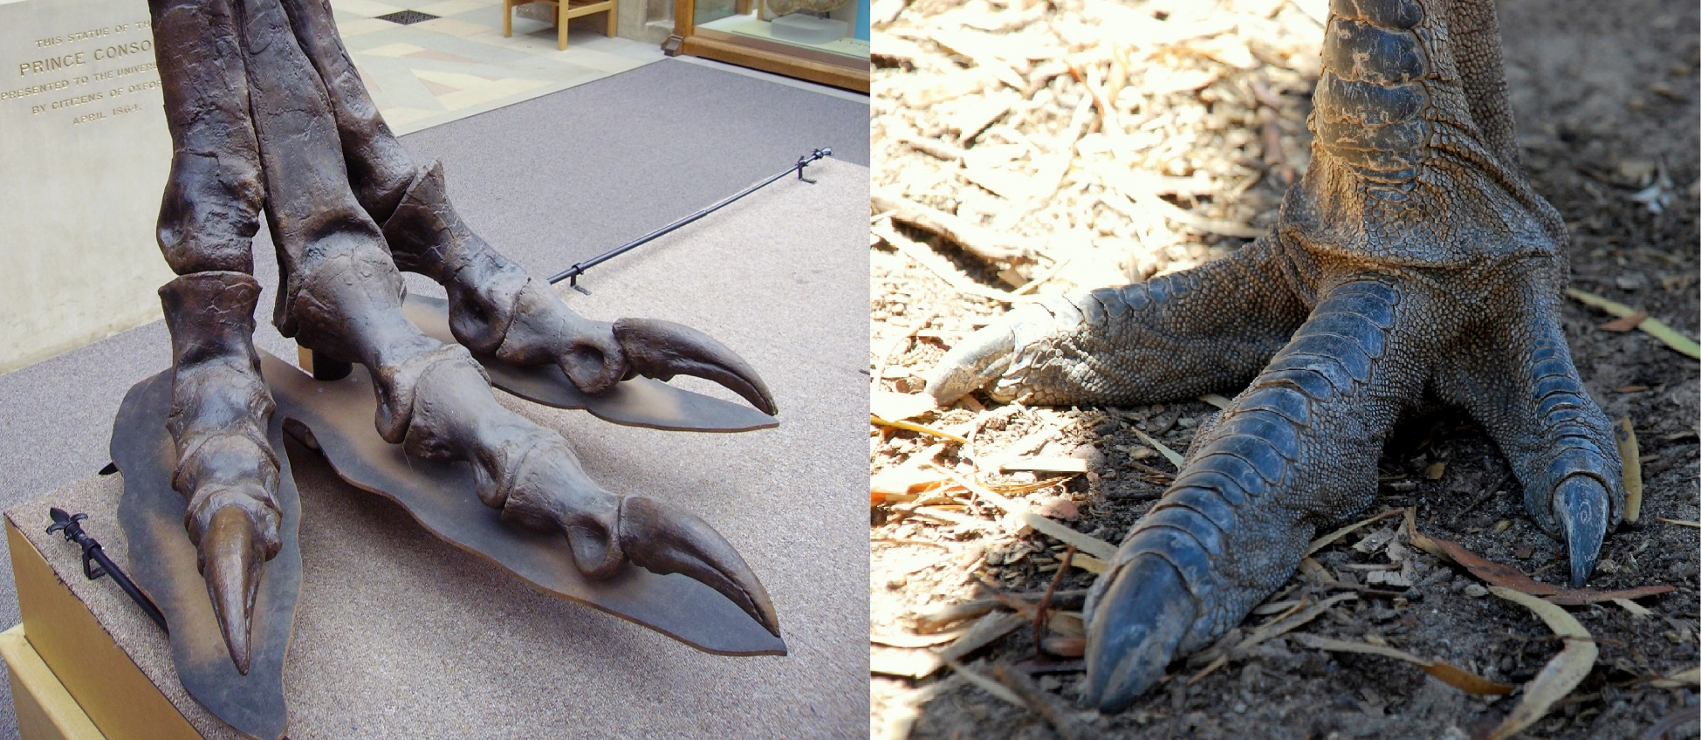
Similarities between organisms
Human & child
T. rex foot
Emu Foot
Bonobo & child
Notes:
We also see similarities between organisms today that strongly support the idea that they once shared a common ancestor.
Biologists have determined that birds evolved from carnivorous dinosaurs. Birds were essentially the only dinosaurs that survived the asteroid strike 60 million years ago. And biologists have come to this conclusion through many lines of evidence built over the last 150 years, but it is actually really easy to see evidence for this just by looking at dinosaur fossils compared to living birds. Here is the fossilized foot of a T. Rex and a living emu. They look very similar because these creatures shared a common ancestor many millions of years ago. In fact, did you know T. Rex also has a wishbone like birds do?
Even among currently living species that are closely related we can see the uncanny resemblance. For instance, we see both physical and behavioral similarities between humans and other great apes.

Slide 35
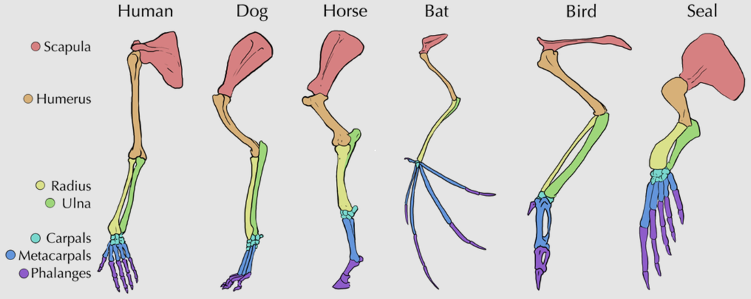
Similarities between organisms
humans & chimps
~96% similar DNA
humans & mice
~70% similar DNA
humans & bananas
~60% similar DNA
Notes:
But even when species look very different from one another, we can detect deeper level similarities that are explained by evolution.
All organisms on Earth share one thing in common: DNA as their genetic code that determines their physical structure. Despite looking very different from mice and bananas humans still share a significant portion of our DNA code with these organisms.
And we see deep structural similarities across very different groups of organisms too. Organisms from very different species like dogs, bats, birds, seals, and humans all have the same foundational components of their limb bones even though their limbs have evolved to do very different things. But whether the limb is being used for flying, swimming, walking, or grasping, each limb has the same bones - a scapula, humerus, radius, and ulna as well carpals, metacarpals, and phalanges. This strongly suggests that these organisms once shared a common ancestor that also had these parts.

Slide 36
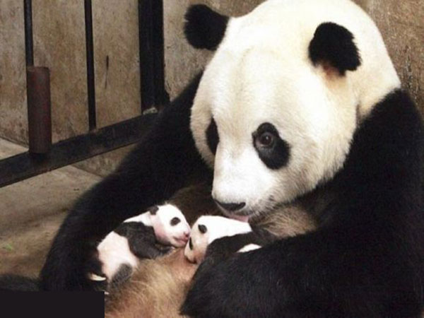
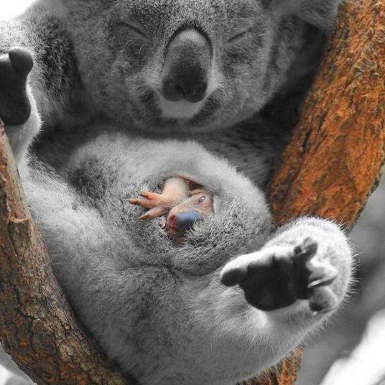
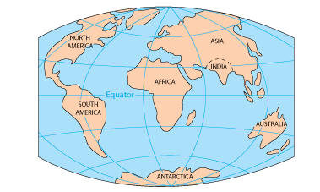
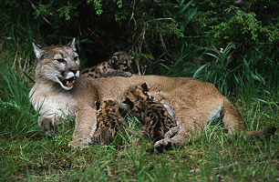
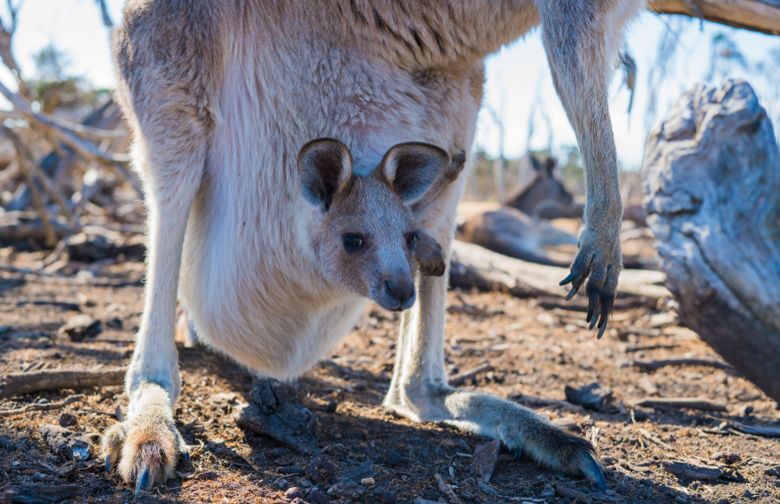
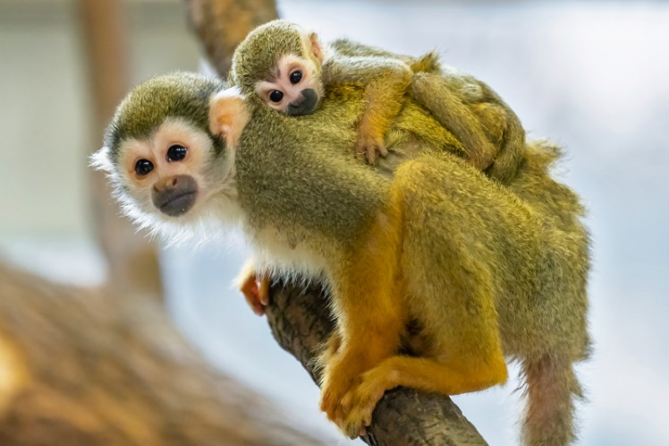
Biogeography
Panda cubs and mother
Juvenile Koala in mother’s pouch
Lion cubs and mother
Infant monkey and mother
Juvenile kangaroo in mother’s pouch
Notes:
We also see strong evidence for evolution from the distribution of plants and animals across planet Earth. Species that are more closely related tend to live in areas together, especially in areas where species have been geographically isolated for long periods of time.
Have you ever wondered why Australia has so many unique mammals that grow their babies in pouches like the kangaroo and koala?
The rest of the Earth is dominated by placental mammals that grow their babies in placentas like pandas, lions, and monkeys. So why do Australian mammals have pouches? Well, evolution explains this!

Slide 37
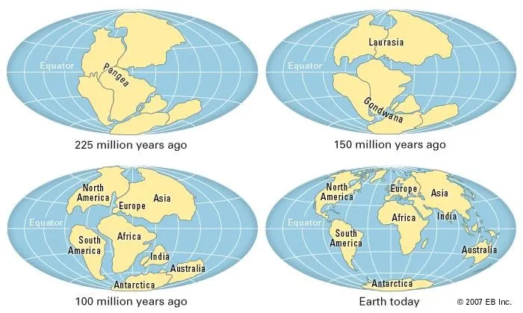
Biogeography is explained by evolution
Marsupials appear in the fossil record
and are found across the Earth
Placental mammals appear in the fossil record
They spread and are found across the Earth
Marsupial fossils simultaneously decline
Marsupials persist and evolve only where placental mammals could not migrate
Notes:
The Earth’s map looked a lot different in the past then it does now and long ago all the continents including Australia were once part of a large land mass called Pangea but continental drift has slowly separated and isolated Australia.
Before this separation marsupials were more evenly distributed across the Earth, but as Australia separated from the super continent,
placental mammals evolved in North America and outcompeted the marsupials across the Earth
– except for Australia where placental mammals could not migrate. And this matches the fossil evidence found in these areas– in geographical layers from deep in the past we see marsupials dispersed more evenly across Earth but in newer layers we see placental mammals appear and then become more abundant everywhere except in Australia. And we see these same sorts of patterns in all sorts of places around the world – especially when we look at islands of land that have been isolated for long periods of time because geographic isolation is a key driver of evolutionary change.

Slide 38
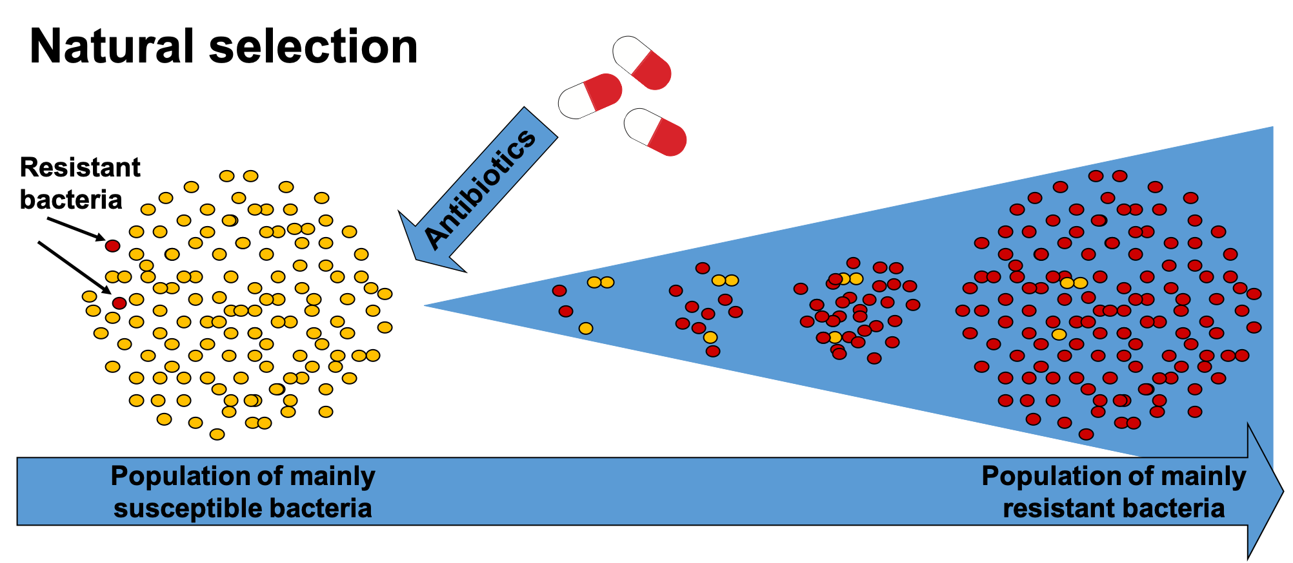
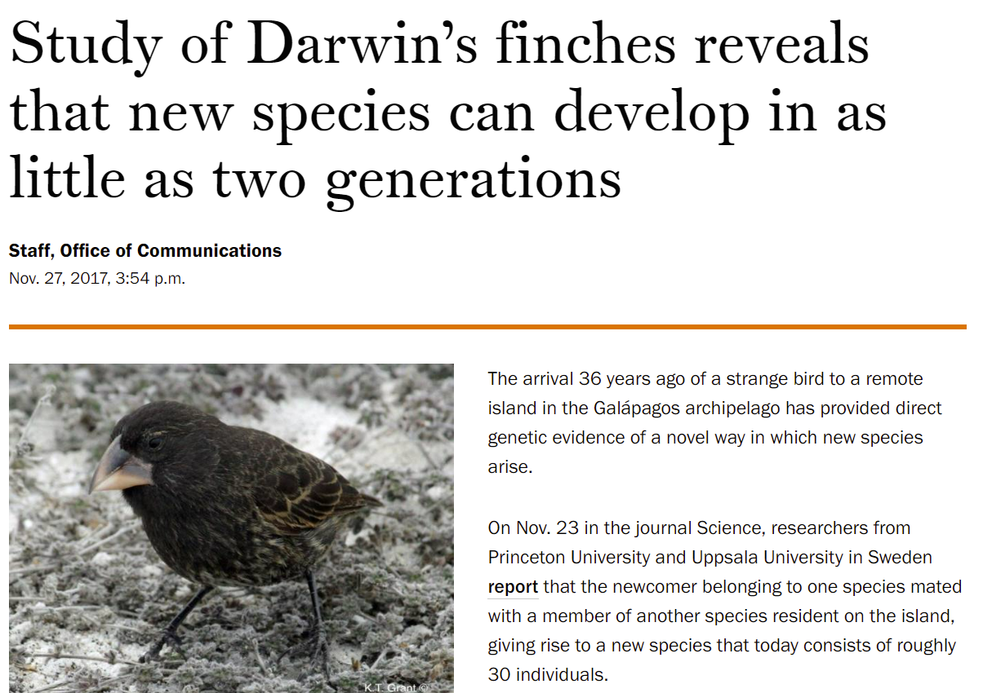
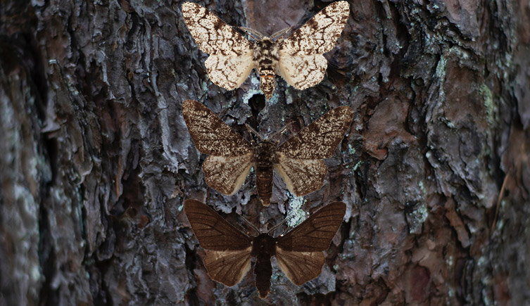
Direct observations of evolution
Antibiotic resistance is evolution
We have seen populations change when their environment changes
Notes:
In fact, we have actually observed speciation happening on islands among finches when conditions suddenly change on an island. And that is the last piece of evidence we will discuss; we continuously have observed evolution taking place in real time.
From antibiotic resistant bacteria, to populations of moths that have changed color in response to industrialization, we have actually seen populations of organisms change over time.

Slide 39



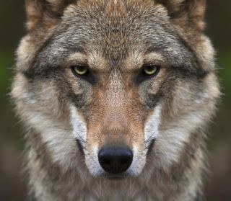



Direct observations of evolution
Chihuahua
Bull dog
St. Bernard
Wolf
Hound dog
Pomeranian
Great Dane
Selective breeding is one of the best direct observations of major evolutionary change in mammals
Notes:
And humans have even learned how to harness and control this process… dog breeding is a great example of this. All dogs from a teacup chihuahua to a giant St. Bernard, have evolved from a wolf common ancestor and we know this because humans are the one’s that did it. And we used the same process that evolution does: selection. Just like well adapted organisms are naturally selected to reproduce, we selected dogs based on specific traits we saw as advantageous.

Slide 40
There is grandeur in this view of life, with its several powers originally breathed into an original form; and while this planet has gone on according to the fixed law of gravity, from so simple a beginning endless forms most beautiful and most wonderful have been, and are being, evolved.
– Charles Darwin, The Origin of Species (1859)
Thank you so much for your time!
Notes:
And all of this evidence I presented here are just tiny pieces of the grand puzzle evolutionary biologists have been putting together for at least 150 years since Charles Darwin published the Origin of Species in 1859. There are thousands of more examples we could find in the published literature documenting more of these evidences. And as Charles Darwin said at the end of the Origin of Species, this view of life is elegant, grand, and beautiful – the discovery that every living thing on this planet is related to one another and has come from so simple a beginning and that over billions of years single celled organisms evolved to multicellular organisms and then the plants, animals, and humans that walk the Earth today is astonishing.
Thank you so much for your time and I sincerely hope this lesson will help you with your future learning of evolution in your biology classes!

